Slide 1
Automation of Adaptive Human-Robot Handovers
Joshua Vahala
With Bilge Mutlu and Rob Nowak

Slide 2
Overview
Motivation and Prior Work
Current Progress
Next Steps and Potential Roadblocks

Slide 3
Motivation and Prior Work
Understanding what makes good human-robot handovers.
Chien-Ming Huang, Maya Cakmak, Bilge Mutlu. “Adaptive Coordination Strategies for Human-Robot Handovers”. Robotics: Science and Systems XI, 2015.

Slide 4

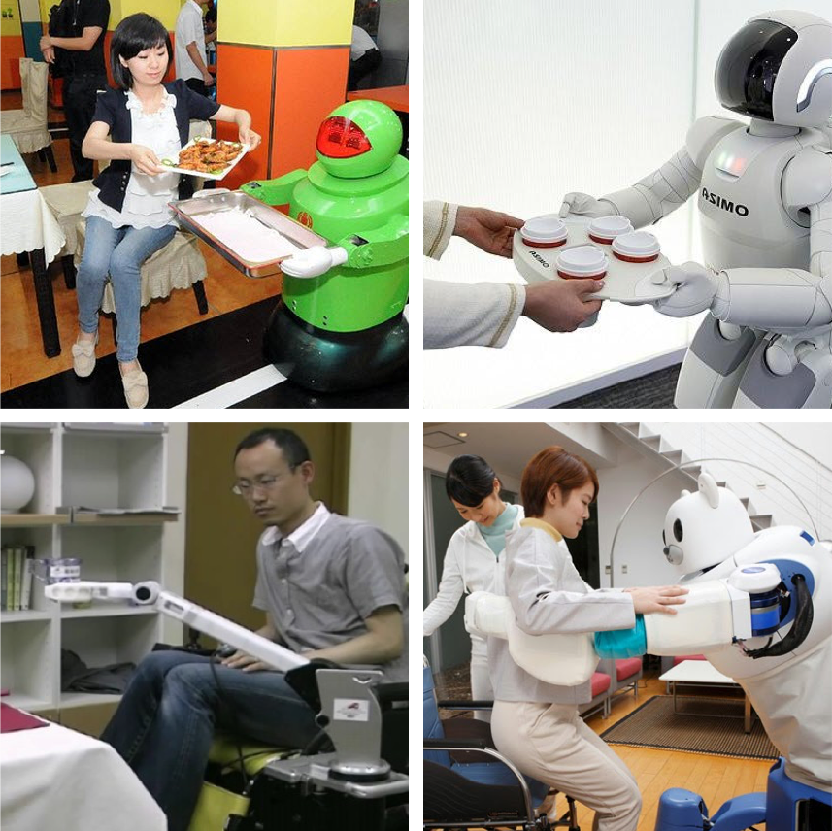
Joint Action
Definition:
Multiple agents engaging in social interaction to coordinate their actions toward changing their environment.
Sebanz et al., 2006

Slide 5
Human-Robot Handovers
Does an adaptive handover strategy matter?
Can we avoid frustration?
What makes a good handover?
…
...Start with how humans perform handovers
Image: Global Robots LTD

Slide 6
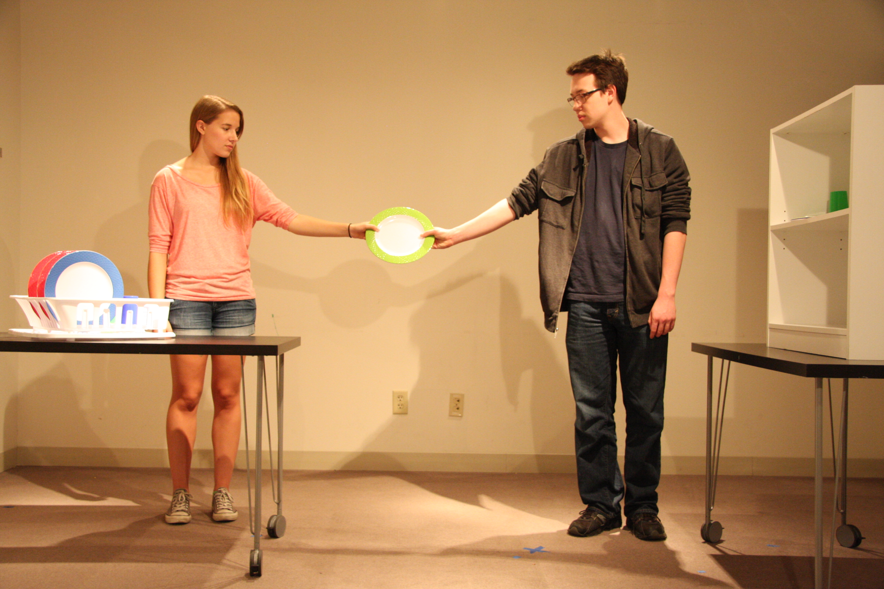
Joint Action Process

Slide 7
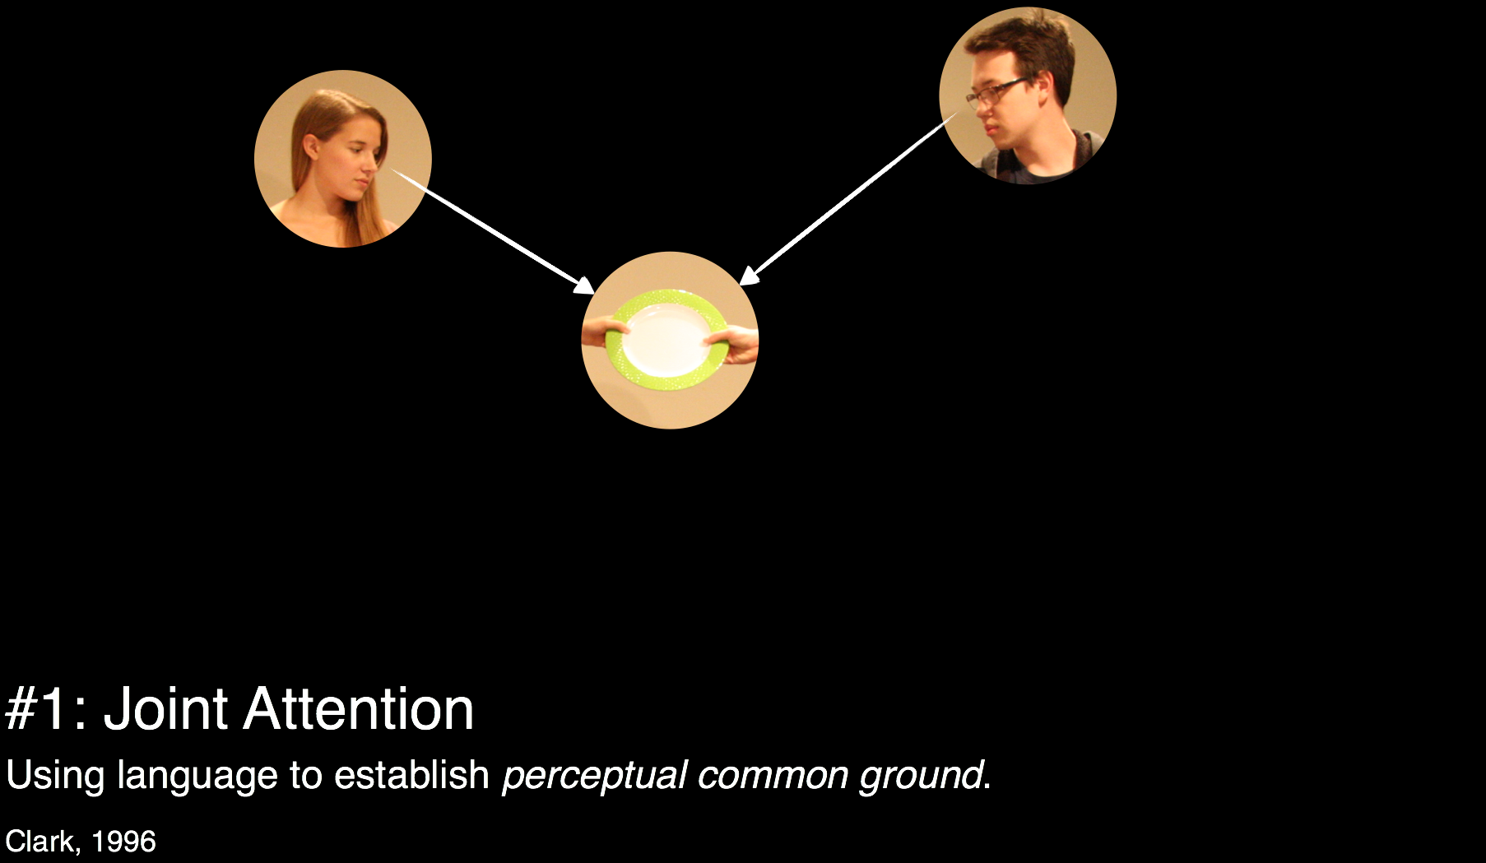
Joint Action Process (1/5)
This is what we are both paying attention to…

Slide 8
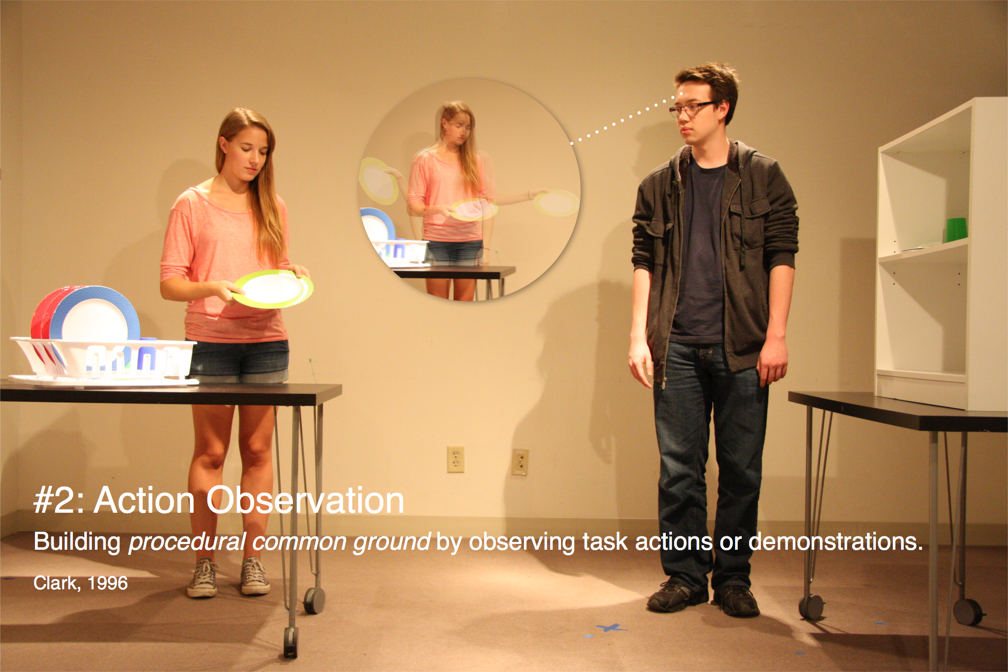
Joint Action Process (2/5)
So that’s how the plate is retrieved!

Slide 9
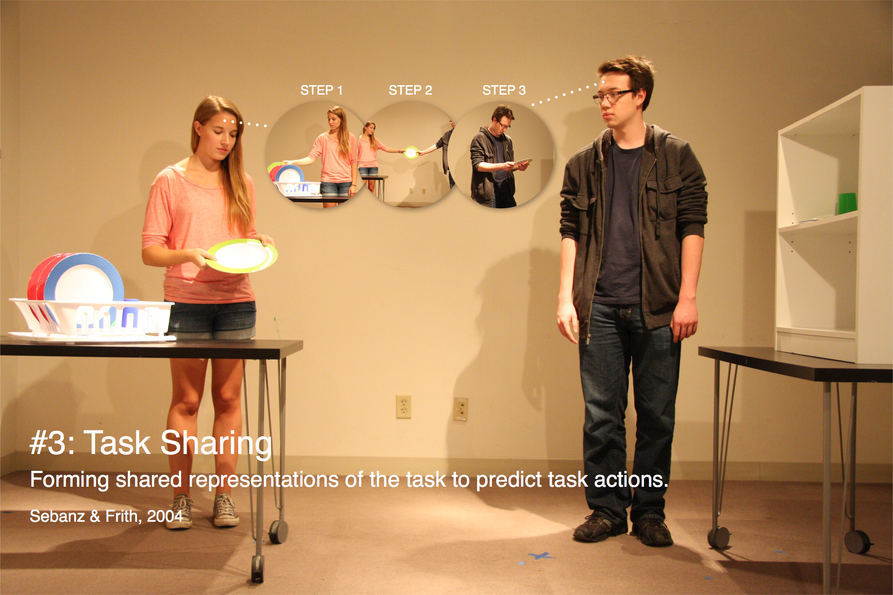
Joint Action Process (3/5)
This is how the task is done…

Slide 10
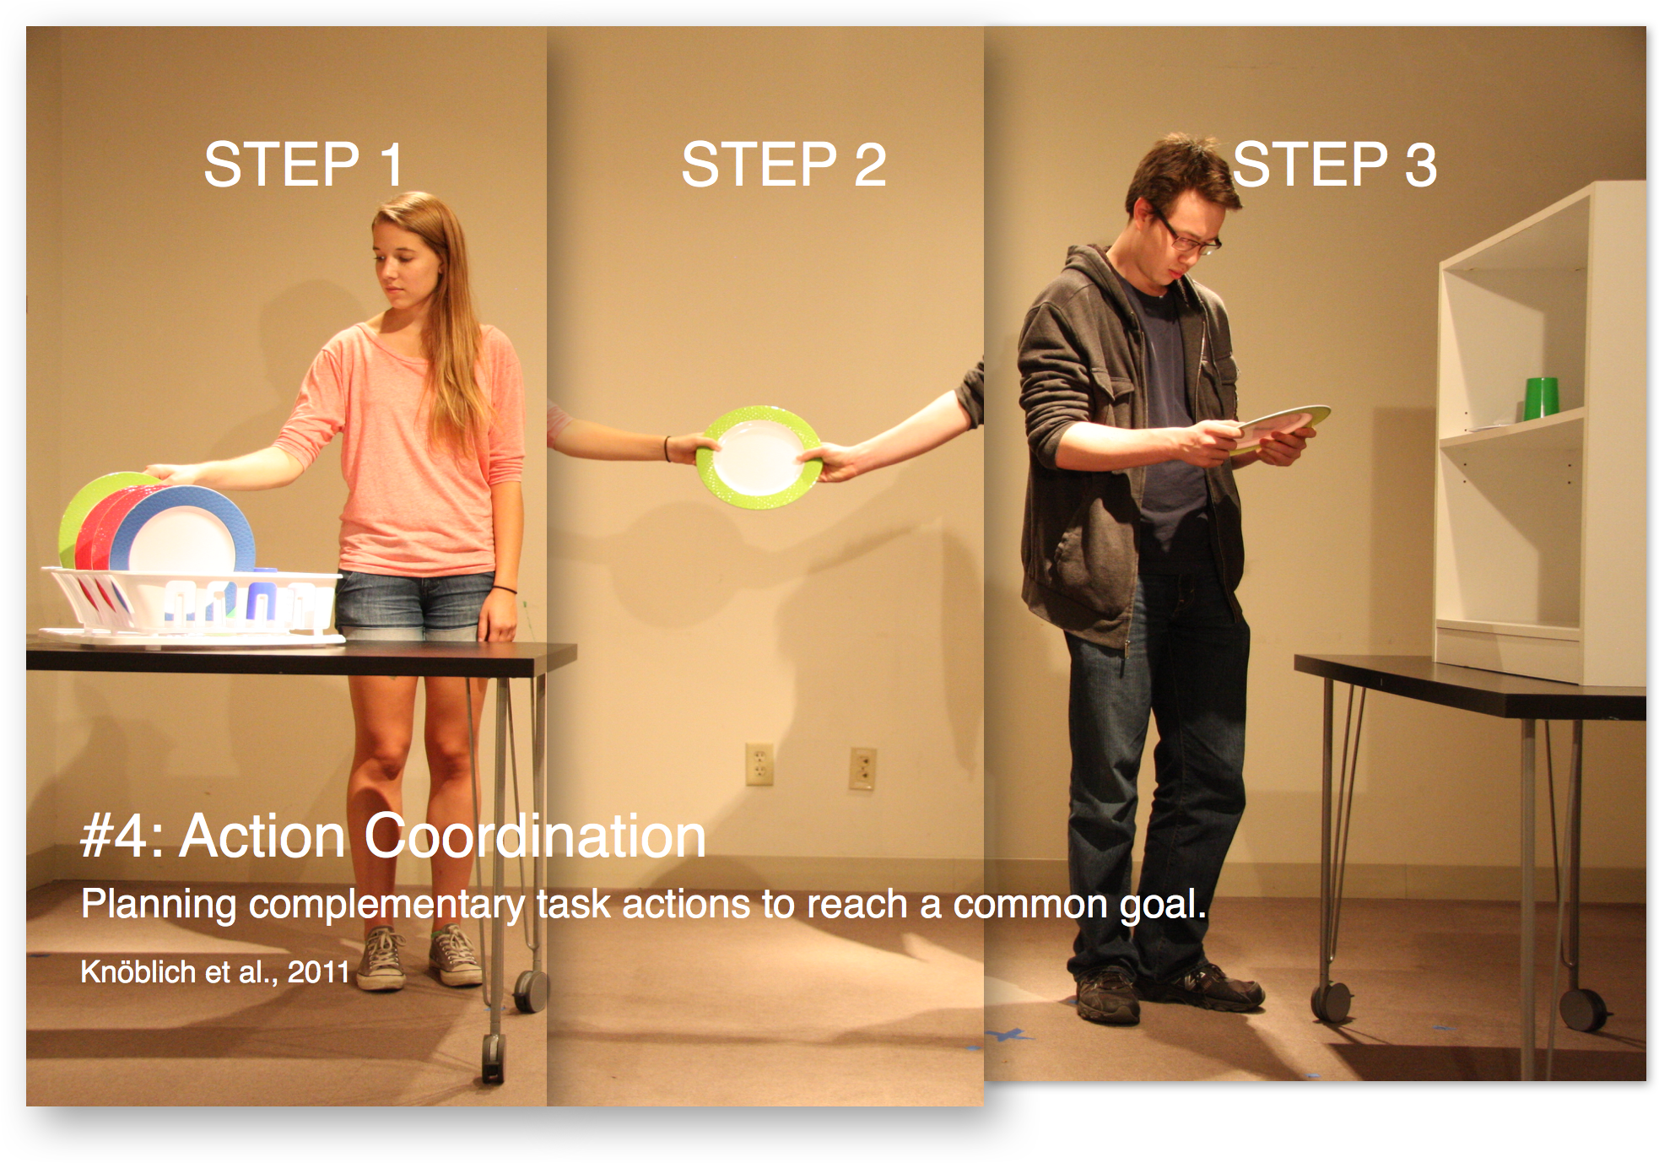
Joint Action Process (4/5)
This is my part…
…we do this together...
…this is my part.

Slide 11
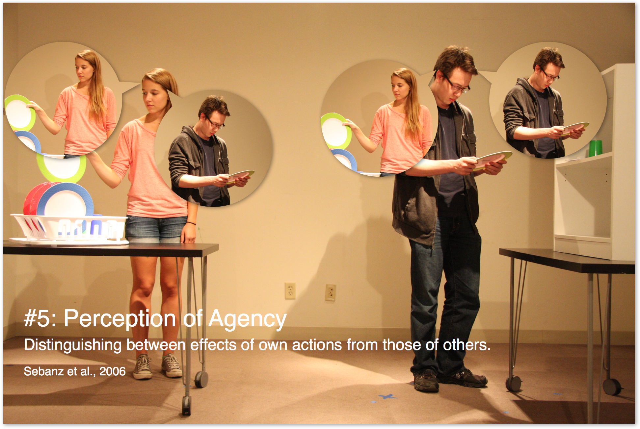
Joint Action Process (5/5)
I am retrieving...
I am placing...
She is retrieving...
He is placing...

Slide 12
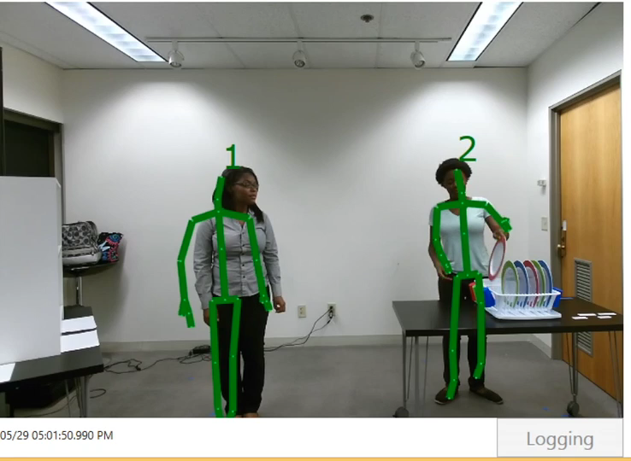
Modeling – Low Task Load

Slide 13
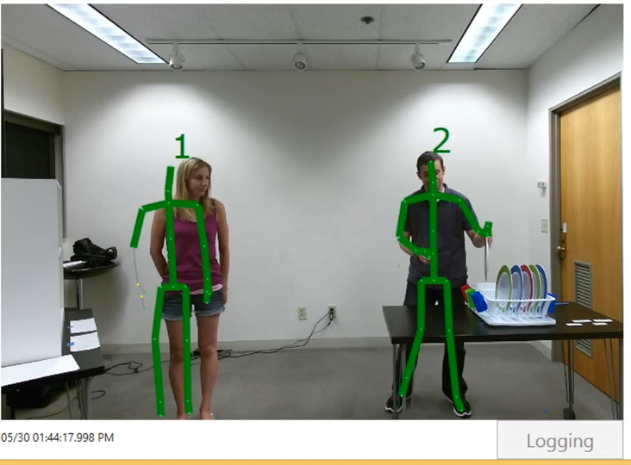
Modeling – High Task Load

Slide 14
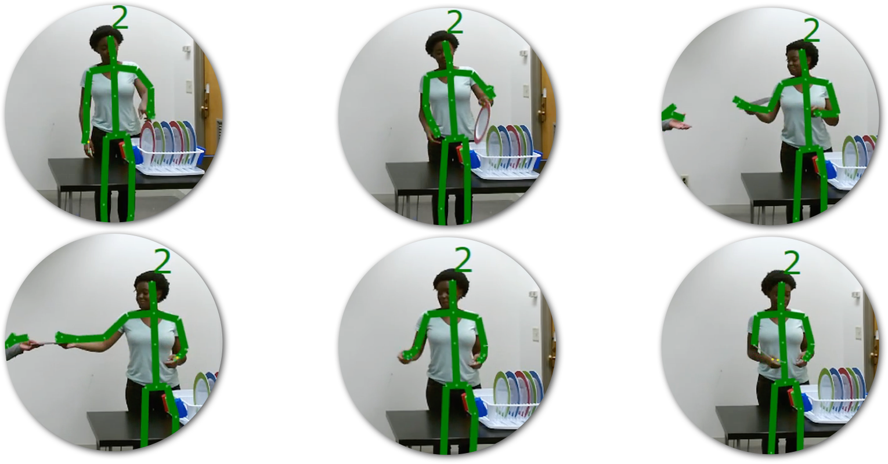
Modeling – Giver States
1. Reach
2. Retrieve
3. Give
4. Handover
5. Retract
6. Idle

Slide 15
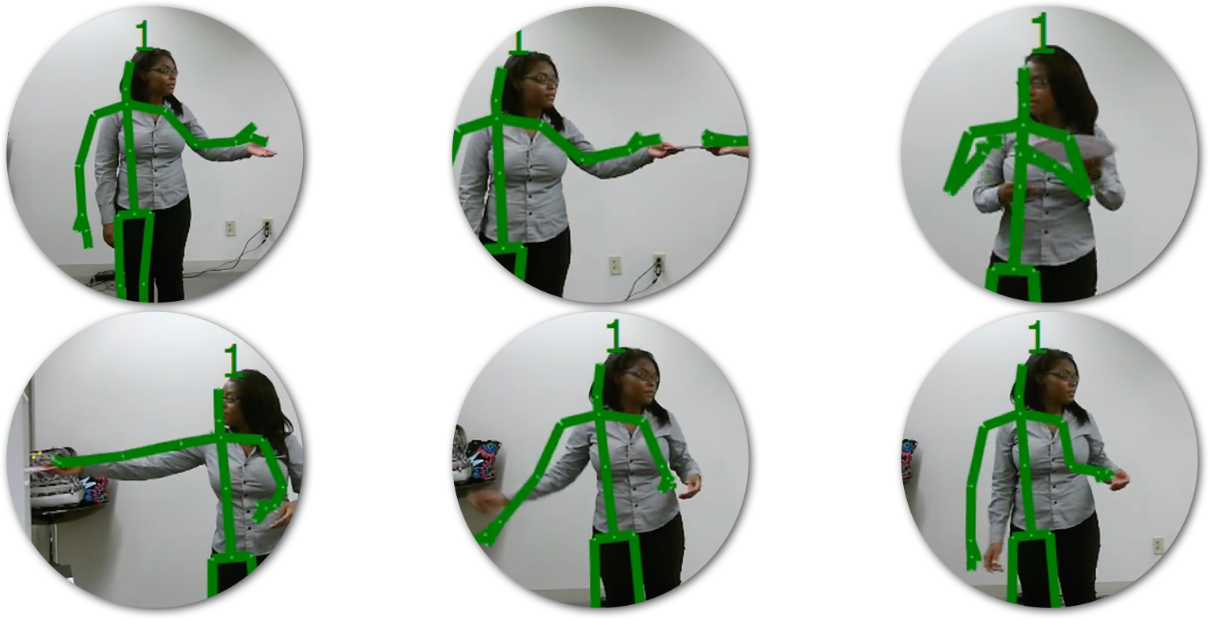
Modeling – Receiver States
1. Take
2. Handover
3. Retrieve
4. Place
5. Retract
6. Idle

Slide 16

Modeling – Find Trends
Giver may try waiting or slowing down methods while partner is busy
Waiting in idle state…
Slowing down motions…

Slide 17
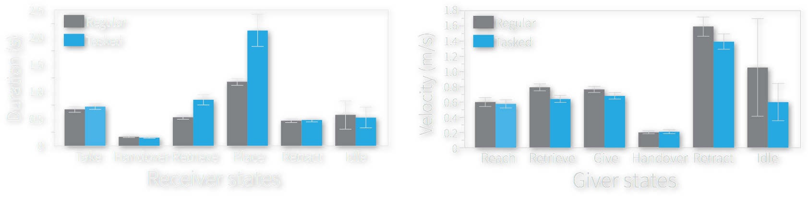

Modeling – Find Trends
When are waiting or slowing down used?
During these Receiver states
During these Giver states

Slide 18
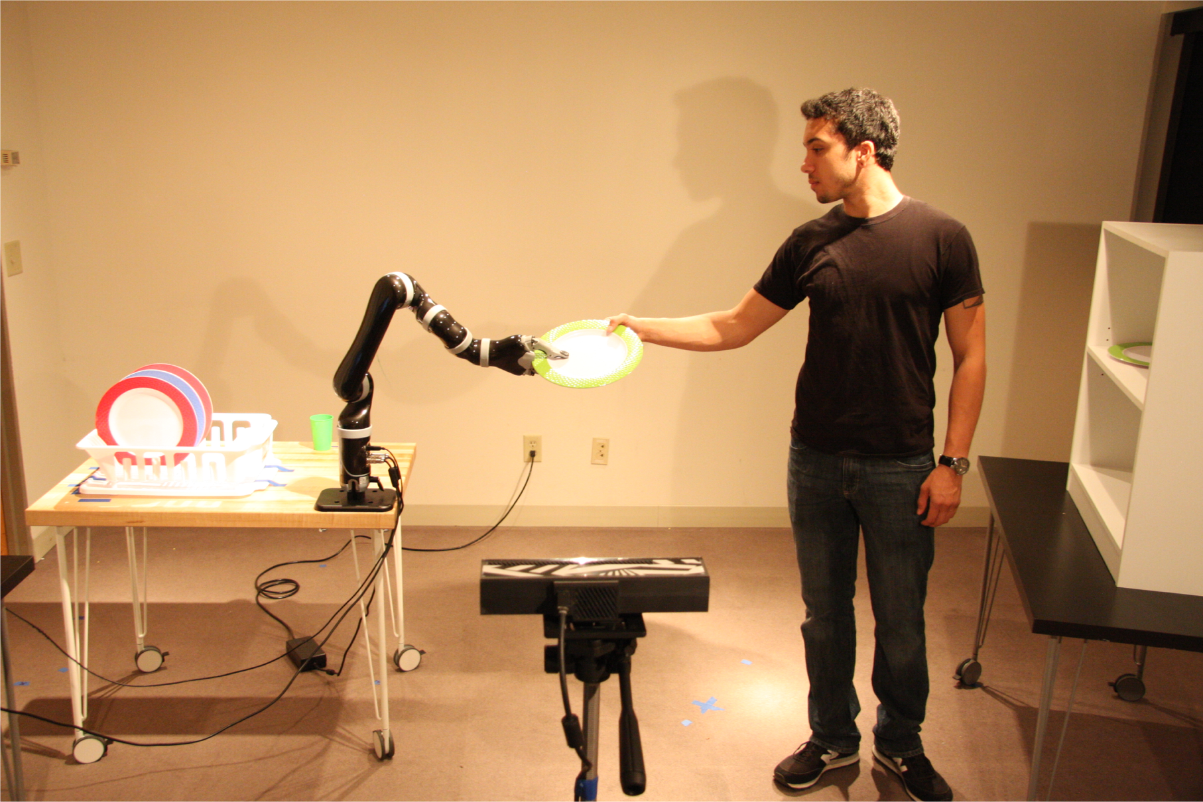
Implementation – Setup
Three handover strategies: proactive, reactive, adaptive
Two tasks loads: low, high
Human receiver
Robot giver
Recognition Camera
(Kinect)
During these Giver states

Slide 19

Coordination Strategies

Slide 20
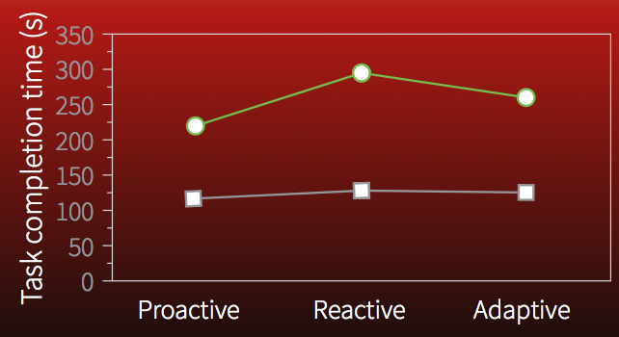
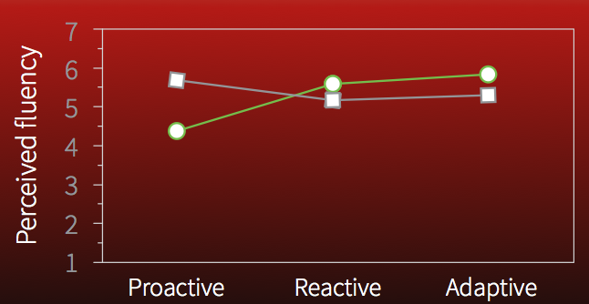
Evaluation
Maximizing team performance not always best for user experience
Shared human-robot task models facilitate coordination
Signaling importance of human actions is important for user experience
Coordinating actions improves performance over simply signaling awareness
Team Performance
User Experience

Slide 21
Limitations – Overview
Explicitly defined receiver/giver states
Explicitly defined handover task
Limited adaptive strategies
Limited robot arm trajectory

Slide 22
Limitations – 1. Explicitly defined receiver/giver states
1. Take
2. Handover
3. Retrieve
4. Place
5. Retract
6. Idle

Slide 23
Limitations – 2. Explicitly defined handover task
Grab object
Place object
Math problem
High Task Load Process

Slide 24
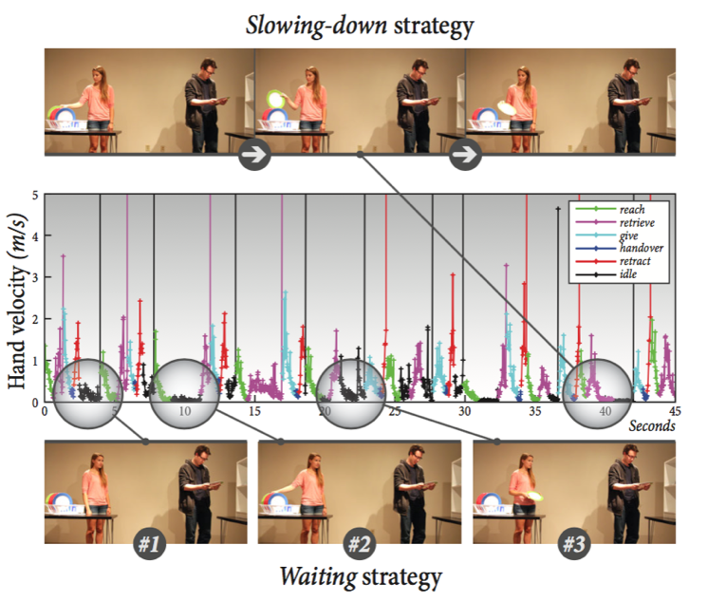
Limitations – 3. Limited adaptive strategies

Slide 25
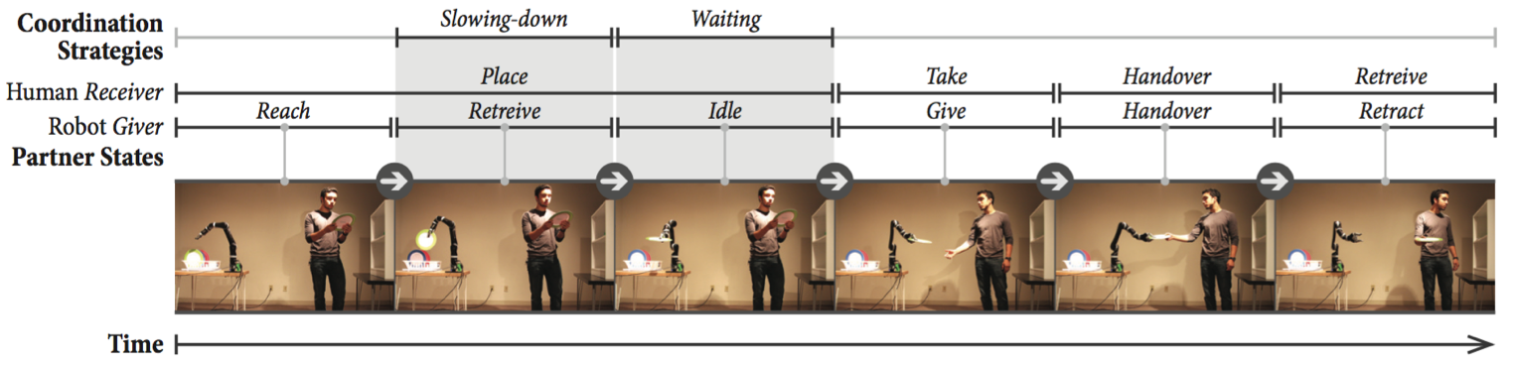
Limitations – 4. Limited robot arm trajectory
Notes:
Height, reach, release, etc.

Slide 26
Current Progress
Addressing limitations in previous handover study.

Slide 27
Unsupervised state classification
What data do we have?
How do we choose features?
How do we define states?

Slide 28
What data do we have?
Xbox Kinect joint recordings from human-to-human handovers.
Rate ~ 30 frames per second
Eight human pairs
Ten handover tasks for each pair (hand annotated)
Timestamp personID ShoulderLeft.X ShoulderLeft.Y ShoulderLeft.Z ShoulderRight.X …
05/29 01:36:20.450 PM 4 -1.045106 -0.06555767 2.525875 -0.8092853 ...
05/29 01:36:20.456 PM 5 0.3154858 0.02824473 3.003953 0.5890724 ...
05/29 01:36:20.491 PM 4 -1.044932 -0.06561549 2.528159 -0.8053343 …
... ... ... ... ... ... ...

Slide 29
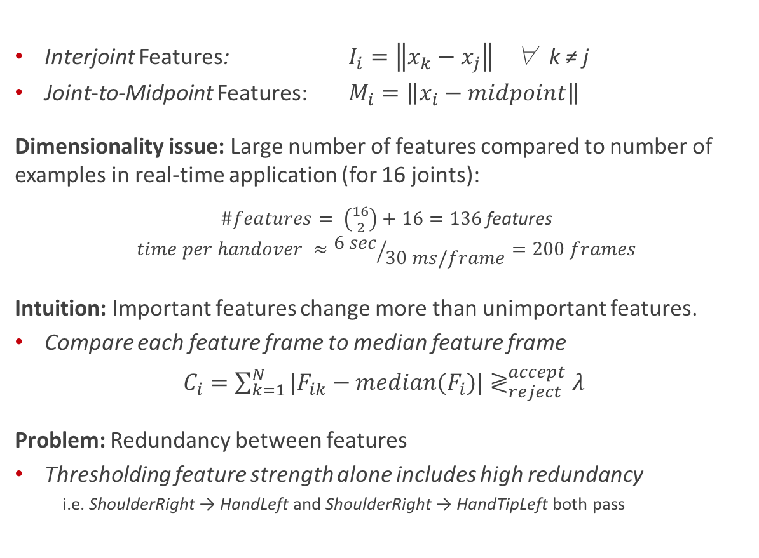
How do we choose features F_{i}?
Interjoint Features: $I_{i}=\left\|x_{k}−x_{j}\right\|$∀ k ≠ j
Joint-to-Midpoint Features: $M_{i}=\left\|x_{i}−midpoint\right\|$
Dimensionality issue: Large number of features compared to number of examples in real-time application (for 16 joints):
$\#features= \left({16 \atop 2}\right)+16=136$ features
$$time per handover ≈{6 sec}/{30 ms/frame}=200 frames$$
Intuition: Important features change more than unimportant features.
Compare each feature frame to median feature frame
$C_{i}=\sum_{k=1}^{N}{{|F}_{ik}−median(F_{i})|≷_{reject}^{accept}λ }$
Problem: Redundancy between features
Thresholding feature strength alone includes high redundancy
i.e. ShoulderRight → HandLeft and ShoulderRight → HandTipLeft both pass

Slide 30
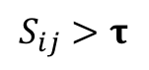
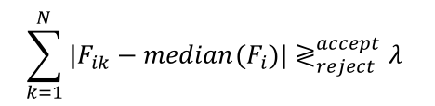
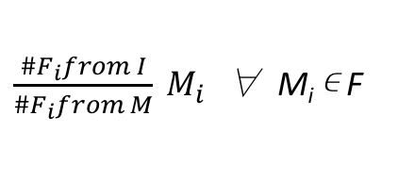
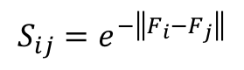
Removing feature redundancy
For each feature group (interjoint vs. joint-to-midpoint),
Compute similarity between features:
Group like features according to a threshold 𝛕:
Select one feature from each group.
Compare features to median and select according to a threshold λ:
Weight features by feature group to account for count differences:
$$S_{ij}=e^{−\left\|F_{i}−F_{j}\right\|}$$
If F_{i} and F_{j} are in same group
$$S_{ij}>\text{τ}$$
$$\sum_{k=1}^{N}{{|F}_{ik}−median(F_{i})|≷_{reject}^{accept}λ }$$
$\frac{\#F_{i}from I}{\#F_{i}from M} M_{i}$ ∀ M_{i} ∊ F

Slide 31
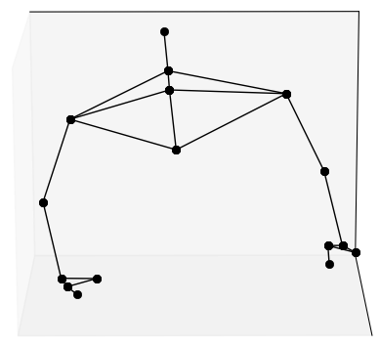
Removing feature redundancy – Example Results
Features (no group thresholding) Features (with group thresholding)
Feature 81: HandLeft to HandTipRight
Feature 75: HandLeft to HandRight
Feature 133: HandTipRight to Midpoint
Feature 62: WristLeft to HandTipRight
Feature 114: HandTipLeft to HandTipRight
Feature 117: HandTipRight to ThumbLeft
Feature 56: WristLeft to HandRight
Feature 83: HandLeft to ThumbRight
Feature 88: HandRight to HandTipLeft
Feature 90: HandRight to ThumbLeft
Feature 65: WristRight to HandLeft
Feature 116: HandTipLeft to ThumbRight
Feature 135: ThumbRight to Midpoint
Feature 71: WristRight to HandTipLeft
Feature 54: WristLeft to WristRight
Feature 75: HandLeft to HandRight
Feature 133: HandTipRight to Midpoint
Feature 134: ThumbLeft to Midpoint
Feature 120: ShoulderLeft to Midpoint
R
L
decreasing strength
midpoint

Slide 32
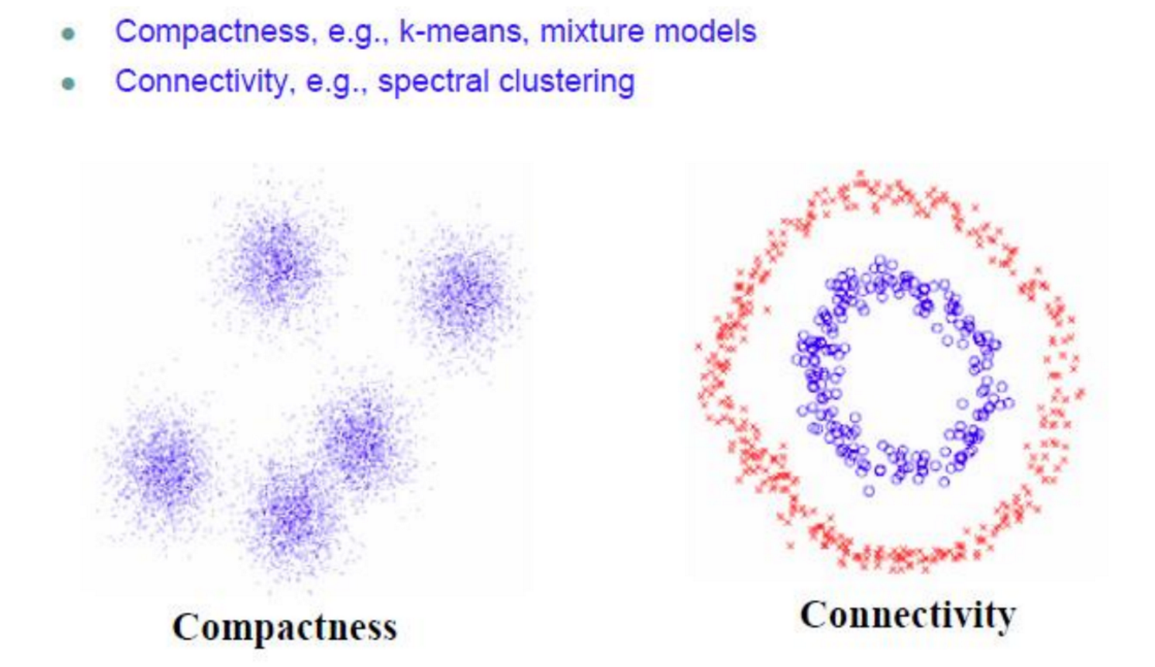
How do we define states?
Spectral Clustering – unsupervised learning
Image credit: https://charlesmartin14.wordpress.com/2012/10/09/spectral-clustering/

Slide 33
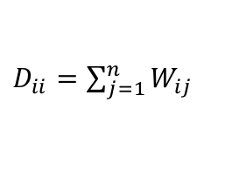
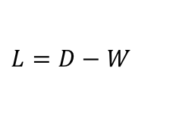
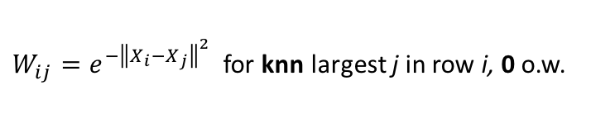
Spectral Clustering Algorithm
Input: X = (n x p) feature array, knn = # nearest neighbors, k = number of clusters, d = embedding dimension
Output: Z = (n x 1) group labels, C = (k x d) locations of group centers
Compute W, Similarity Matrix from X
Compute D, the Degree Matrix from W
Compute L, the Laplacian Matrix from W and D
Compute SVD of L (one or more singular values will be 0)
Using the basis vectors associated with the d smallest singular values, use kmeans++ to return the Z and C.
$W_{ij}=e^{−{\left\|X_{i}−X_{j}\right\|}^{2}}$for knn largest j in row i, 0 o.w.
$D_{ii}=\sum_{j=1}^{n}{W_{ij}}$
$L=D−W$

Slide 34
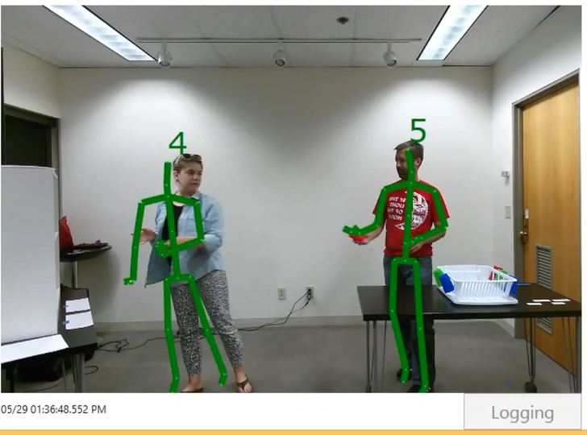
Handover Classification Results – Base Video

Slide 35
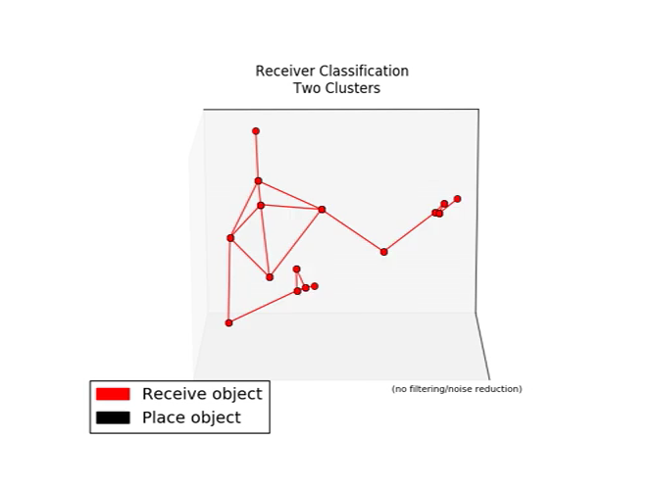
Handover Classification Results – Two Clusters
1. Take
2. Handover
3. Retrieve
4. Place
5. Retract
6. Idle
Notes:
labels: [0, 0, 0, 0, 0, 0, 0, 0, 0, 0, 0, 0, 0, 0, 1, 1, 1, 1, 1, 1, 1, 1, 1, 1, 1, 1, 1, 1, 1, 1, 1, 1, 1, 1, 1, 1, 1, 1, 1, 1, 1, 1, 1, 1, 1, 1, 1, 1, 1, 1, 1, 1, 1, 1, 1, 1, 1, 1, 1, 1, 1, 1, 1, 1, 1, 1, 1, 1, 1, 1, 1, 1, 1, 1, 1, 1, 1, 1, 1, 1, 1, 1, 1, 1, 1, 1, 1, 1, 1, 1, 1, 1, 1, 1, 1, 1, 1, 1, 1, 1, 1, 1, 1, 1, 1, 1, 1, 1, 1, 1, 1, 1, 1, 1, 1, 1, 1, 1, 1, 1, 1, 1, 1, 1, 1, 1, 1, 1, 1, 1, 1, 1, 1, 1, 1, 1, 1, 1, 1, 1, 1, 1, 1, 1, 1, 1, 1, 1, 1, 1, 1, 1, 1, 1, 1, 1, 0, 0, 0, 0, 0, 0, 0, 0, 0, 0, 0, 0, 0, 0, 0, 0, 0, 0, 0, 0, 0, 0, 0, 0, 0, 0, 0, 0, 0, 0, 0, 0, 0, 1, 1, 1, 1, 1, 1, 1, 1, 1, 1, 1, 1, 1, 1, 1, 1, 1, 1, 1, 1, 1, 1, 1, 1, 1, 1, 1, 1, 1, 1, 1, 1, 1, 1, 1, 1, 1, 1, 1, 1, 1, 1, 1, 1, 1, 1, 1, 1, 1, 1, 1, 1, 1, 1, 1, 1, 1, 1, 1, 1, 0, 0, 0, 0, 0, 0, 0, 0, 0, 0, 0, 0, 0, 0, 0, 0, 0, 0, 0, 0, 0, 0, 0, 0, 0, 0, 0, 0, 0, 0, 0, 0, 0, 0, 0, 0, 0, 0, 0, 1, 1, 1, 1, 1, 1, 1, 1, 1, 1, 1, 1, 1, 1, 1, 1, 1, 1, 1, 1, 1, 1, 1, 1, 1, 1, 1, 1, 1, 1, 1, 1, 1, 1, 1, 1, 1, 1, 1, 1, 1, 1, 1, 1, 1, 1, 1, 1, 1, 1, 1, 1, 1, 1, 1, 1, 0, 0, 0, 0, 0, 0, 0, 0, 0, 0, 0, 0, 0, 0, 0, 0, 0, 0, 0, 0, 0, 0, 0, 0, 0, 0, 0, 0, 0, 0, 0, 0, 0, 0, 0, 0, 0, 0, 0, 0, 0, 0, 0, 0, 1, 1, 1, 1, 1, 1, 1, 1, 1, 1, 1, 1, 1, 1, 1, 1, 1, 1, 1, 1, 1, 1, 1, 1, 1, 1, 1, 1, 1, 1, 1, 1, 1, 1, 1, 1, 1, 1, 1, 1, 1, 1, 1, 1, 1, 1, 1, 1, 1, 0, 0, 0, 0, 0, 0, 0, 0, 0, 0, 0, 0, 0, 0, 0, 0, 0, 0, 0, 0, 0, 0, 0, 0, 0, 0, 0, 0, 0, 0, 0, 0, 0, 0, 0, 0, 0, 0, 0, 0, 0, 0, 0, 0, 0, 0, 0, 0, 0, 0, 0, 0, 0, 0, 0, 0, 0, 0, 0, 0, 0, 0, 0, 0, 0, 0, 0, 1, 1, 1, 1, 1, 1, 1, 1, 1, 1, 1, 1, 1, 1, 1, 1, 1, 1, 1, 1, 1, 1, 1, 1, 1, 1, 1, 1, 1, 1, 1, 1, 1, 1, 1, 1, 1, 1, 1, 1, 1, 1, 1, 1, 1, 1, 1, 1, 1, 1, 1, 1, 1, 1, 1, 1, 0, 0, 0, 0, 0, 0, 0, 0, 0, 0, 0, 0, 0, 0, 0, 0, 0, 0, 0, 0, 0, 0, 0, 0, 0, 0, 0, 0, 0, 0, 0, 0, 0, 0, 0, 0, 0, 0, 0, 0, 1, 1, 1, 1, 1, 1, 1, 1, 1, 1, 1, 1, 1, 1, 1, 1, 1, 1, 1, 1, 1, 1, 1, 1, 1, 1, 1, 1, 1, 1, 1, 1, 1, 1, 1, 1, 1, 1, 1, 1, 1, 1, 1, 1, 1, 1, 1, 1, 0, 0]

Slide 36
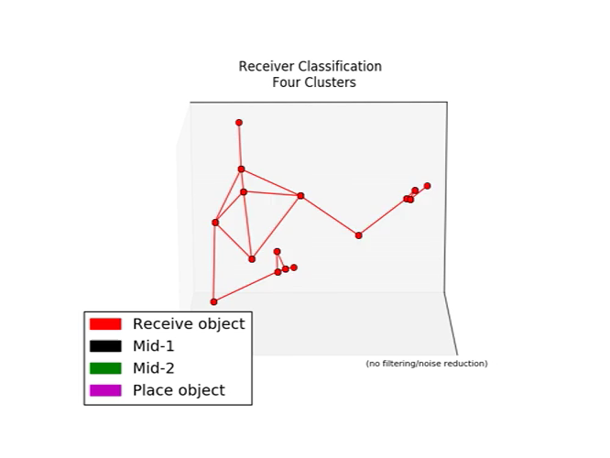
Handover Classification Results – Four Clusters
1. Take
2. Handover
3. Retrieve
4. Place
5. Retract
6. Idle
Notes:
labels: [0, 0, 0, 0, 0, 0, 0, 0, 0, 0, 1, 2, 2, 2, 2, 2, 2, 2, 2, 2, 2, 2, 2, 2, 2, 2, 2, 2, 2, 2, 2, 2, 2, 2, 2, 2, 2, 2, 2, 2, 2, 2, 2, 2, 2, 2, 2, 2, 2, 2, 2, 2, 2, 2, 2, 2, 2, 2, 2, 2, 2, 2, 2, 2, 2, 2, 2, 2, 2, 2, 3, 3, 3, 3, 3, 3, 3, 3, 3, 3, 3, 3, 3, 3, 3, 3, 3, 3, 3, 3, 3, 3, 3, 3, 3, 3, 3, 3, 3, 3, 3, 3, 3, 3, 3, 3, 3, 3, 3, 3, 3, 3, 3, 3, 3, 3, 2, 1, 1, 1, 1, 1, 1, 1, 1, 1, 1, 2, 3, 3, 3, 3, 3, 3, 3, 3, 3, 3, 3, 3, 3, 3, 3, 3, 3, 3, 3, 3, 2, 1, 1, 1, 1, 1, 1, 1, 0, 0, 0, 0, 0, 0, 0, 0, 0, 0, 0, 0, 0, 0, 0, 0, 0, 0, 0, 0, 0, 0, 0, 0, 0, 0, 1, 2, 2, 2, 2, 2, 2, 2, 2, 1, 1, 1, 1, 1, 1, 1, 1, 1, 1, 1, 1, 1, 1, 1, 1, 1, 1, 1, 1, 1, 1, 1, 2, 3, 3, 3, 3, 3, 3, 3, 3, 3, 3, 3, 3, 3, 3, 3, 3, 3, 3, 3, 3, 3, 3, 3, 3, 3, 3, 3, 2, 1, 1, 1, 1, 1, 1, 1, 2, 2, 1, 0, 0, 0, 0, 0, 0, 0, 0, 0, 0, 0, 0, 0, 0, 0, 0, 0, 0, 0, 0, 0, 0, 0, 0, 0, 0, 0, 0, 0, 0, 1, 2, 2, 2, 2, 2, 2, 1, 1, 1, 1, 1, 1, 1, 1, 1, 1, 1, 1, 1, 1, 1, 1, 1, 1, 1, 1, 1, 1, 1, 1, 2, 3, 3, 3, 3, 3, 3, 3, 3, 3, 3, 3, 3, 3, 3, 3, 3, 3, 3, 3, 3, 3, 3, 3, 3, 3, 2, 2, 1, 2, 2, 2, 1, 0, 0, 0, 0, 0, 0, 0, 0, 0, 0, 0, 0, 0, 0, 0, 0, 0, 0, 0, 0, 0, 0, 0, 0, 0, 0, 0, 0, 0, 0, 0, 0, 0, 0, 0, 0, 0, 1, 2, 2, 2, 2, 1, 1, 1, 1, 1, 1, 1, 1, 1, 1, 1, 1, 1, 1, 1, 1, 2, 3, 3, 3, 3, 3, 3, 3, 3, 3, 3, 3, 3, 3, 3, 3, 3, 3, 3, 3, 3, 3, 3, 3, 3, 2, 1, 1, 1, 1, 1, 2, 2, 2, 2, 1, 0, 0, 0, 0, 0, 0, 0, 0, 0, 0, 0, 0, 0, 0, 0, 0, 0, 0, 0, 0, 0, 0, 0, 0, 0, 0, 0, 0, 0, 0, 0, 0, 0, 0, 0, 0, 0, 0, 0, 0, 0, 0, 0, 0, 0, 0, 0, 0, 0, 0, 0, 0, 0, 0, 0, 0, 0, 1, 2, 2, 2, 2, 2, 2, 2, 2, 2, 2, 2, 2, 2, 2, 2, 1, 1, 1, 1, 1, 1, 1, 1, 1, 1, 1, 1, 1, 1, 1, 1, 1, 1, 1, 1, 1, 2, 2, 2, 2, 3, 3, 3, 3, 3, 3, 3, 3, 2, 1, 1, 1, 2, 3, 2, 1, 1, 1, 1, 1, 1, 1, 1, 2, 1, 0, 0, 0, 0, 0, 0, 0, 0, 0, 0, 0, 0, 0, 0, 0, 0, 0, 0, 0, 0, 0, 0, 0, 0, 0, 0, 0, 0, 0, 0, 0, 0, 1, 2, 2, 2, 2, 1, 1, 1, 1, 1, 1, 1, 1, 1, 1, 1, 1, 1, 1, 1, 2, 3, 3, 3, 3, 3, 3, 3, 3, 3, 3, 3, 3, 3, 3, 3, 3, 3, 3, 3, 3, 2, 1, 1, 2, 2, 1, 1, 1, 1, 1, 1, 0, 0]

Slide 37
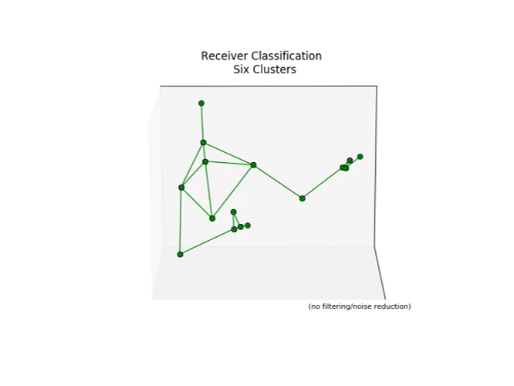
Handover Classification Results – Six Clusters
1. Take
2. Handover
3. Retrieve
4. Place
5. Retract
6. Idle

Slide 38
Next Steps and Potential RoadBlocks
Probabilistic sequencing, partner coordination, robot implementation

Slide 39
Probabilistic Sequencing
Goal: Determine how states exist relative to other states.
How do I find the most informative states in a handover?
How do I determine whether a new handover process has begun?
time
f_{i}
Full task
Same task?
Known states

Slide 40
Partner Coordination
Goal: Determine how human partners coordinate states.
When do joint state changes occur between partners?
How well did slowing-down and waiting make sense?
Any new methods that weren’t noticed?

Slide 41
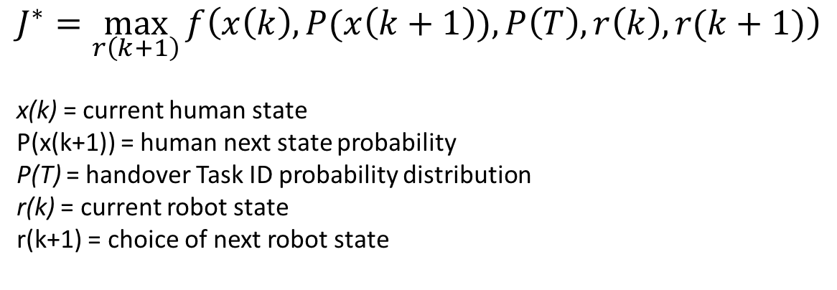
Robot Implementation
Goal: Implement new coordination strategies on robotic manipulator.
Can the robot adapt to changing workloads or inconsistent states?
Does the robot need active feedback?
How would a coordination function J be defined?
$$J^{∗}=\max_{r\left(k+1\right)}{f\left(x\left(k\right),P(x\left(k+1\right)), P\left(T\right), r\left(k\right),r(k+1)\right)}$$
x(k) = current human state
P(x(k+1)) = human next state probability
P(T) = handover Task ID probability distribution
r(k) = current robot state
r(k+1) = choice of next robot state

Slide 42
Thank you! Questions?
Special thanks to
Chris Bodden,
Chien-Ming Huang,
Kwang-Sung Jun,
Bilge Mutlu,
and Rob Nowak

